Slide 1
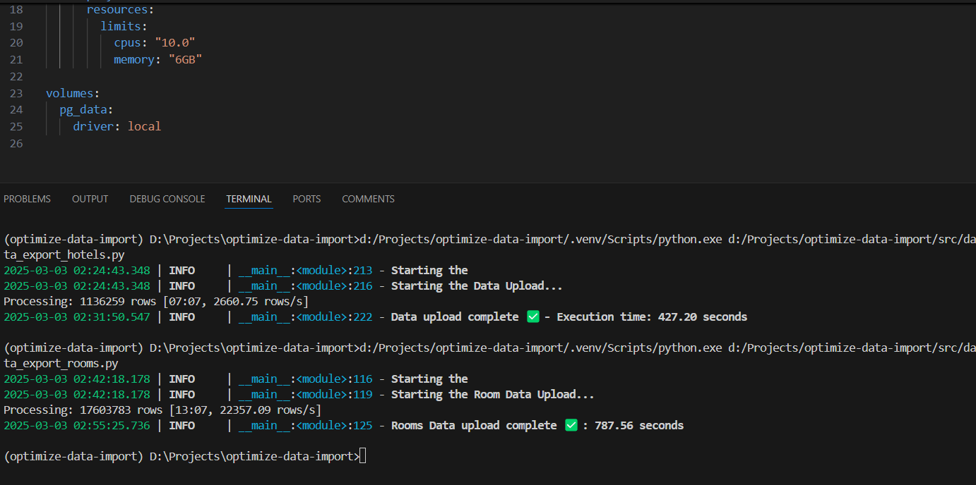
Time to dump hotel data: 7min-7sec
Time to dump room data: 13min-7sec
Total Time Taken: 20min-14sec

Slide 2
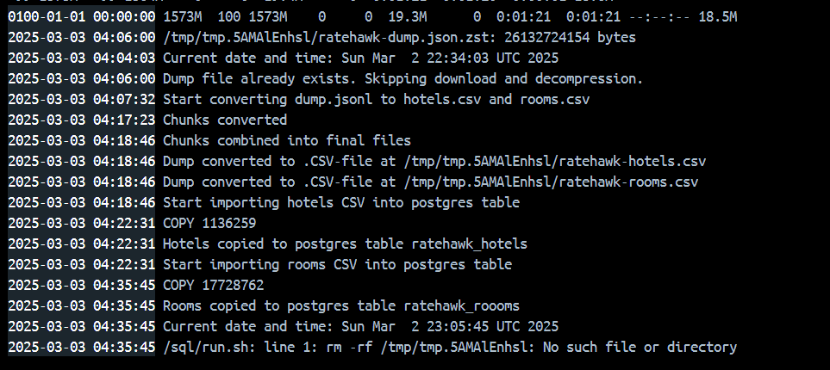
Total Time Taken: 31min 42sec

Slide 3
